Slide 1
Online Portfolio
Bryce Griffin

Slide 2
The Purpose Of The Website
To create a fun and interesting website.
Be able to showcase my pictures I photoshopped.
To show my After Effects project.
To integrate my p5 game into my website.

Slide 3
Purpose Of Each Page
Homepage
To display my headshot, a short bio, and to show the pictures I created in Photoshop.
Video Gallery
To integrate my After Effects video into the website and leave room in the future for my upcoming video projects.
Game
To display and be able to play my p5 game.
Contact Page
To have a room for anyone to be able to contact me.

Slide 4
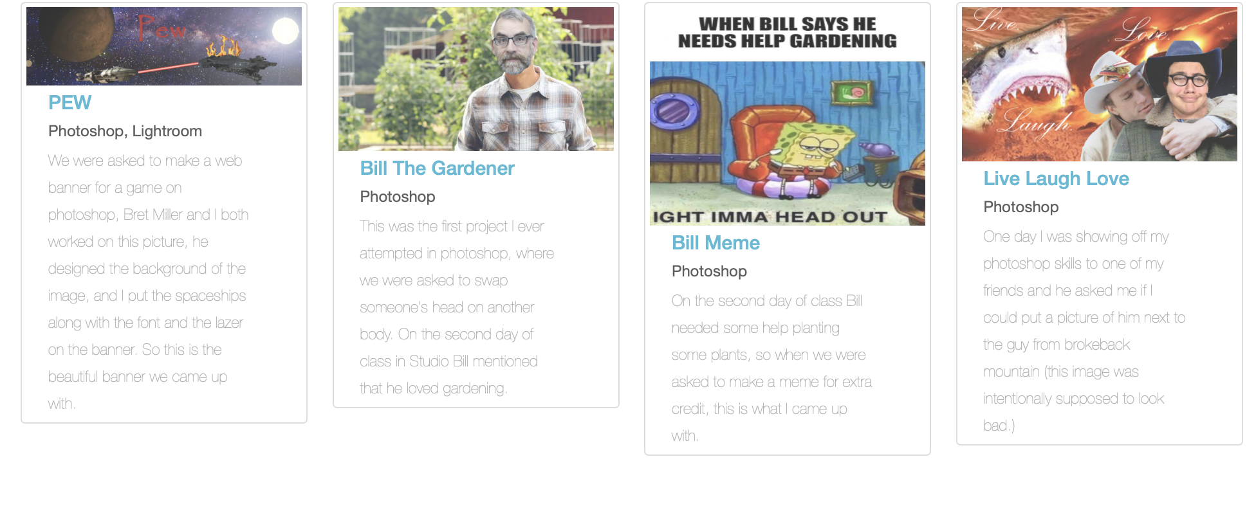
Design Elements
Image Gallery
A function navigation bar
Area for headshot, and short bio
Contact me button at the bottom of each page

Slide 5
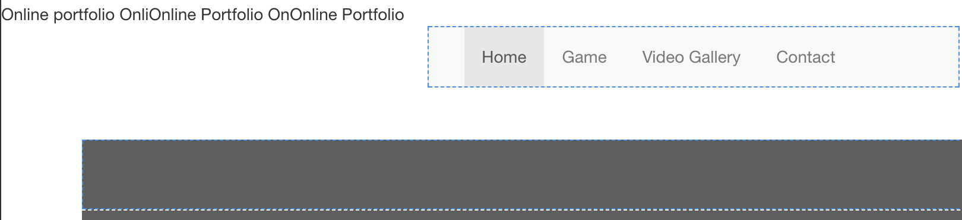
Problems I Encountered
Couldn’t get the text that says “online portfolio” to stay still (wanted to be in the navigation bar.)
To make the website atheistically pleasing.
Had to figure out how to use bootstrap to make my image grid.

Slide 6
What I Learned
Making a website is fun.
Bootstrap will save multiple hours of time.
Navigation bars are never fun to mess with.
Learned how to embed videos / p5 games.

